Slide 1

BIG DATA ANALYTICS AND SUSTAINABILITY OF THE FASHION INDUSTRY

Slide 2
BIG DATA TECHNOLOGIES
DAT7015 ASSESSMENT 2
EKANEM, PERCY
2205247
SUPERVISED BY DR PRADEEP HEWAGE

Slide 3
INTRODUCTION
The fashion industry has evolved a great deal over the centuries, and even more over the last three decades. Clothing has gone from basic protection from harsh weather to a means of expressing one’s individuality and identity. With the evolution of the industry and the rise of the modern age, however, have come unsustainable and environmentally unfriendly practices.
A business model known as fast fashion, which produces trending apparel at high speed and low cost, has taken the world by storm. This is done at the expense of quality and sustainable practices, often using low quality materials and underpaid labour. With the help of big data analytical technologies, this model has been able to thrive.

Slide 4
LITERATURE REVIEW
Big data has become a part of every major fashion brand’s arsenal in recent years (Rajaram, 2001; Pantano et al., 2018), and applications such as data mining and artificial intelligence have been used to maximise profits (Moon and Ngai, 2008; Jain et al., 2017) as well as shorten supply chains of these brands (Madsen et al., 2020).
Fast fashion brands also make use of big data technologies to make their businesses more profitable. They have been known to use data mining to identify fashion trends and reproduce the trending designs using lower quality materials and cheap labour (Choi, 2018; Banner, 2019). While this means clothing is made more affordable, it also greatly reduces the lifespan of these clothing items, leading to waste and environmental pollution (Fletcher, 2008; Niinimäki, 2012).

Slide 5
METHODOLOGY
This paper was divided into two sections; a review of past literature, and the analysis of two fashion industry datasets, in order to answer the following questions:
What part has big data analytics played in the growth of the fast fashion industry?
How can big data analytics be applied to make fashion more sustainable?
Literature was obtained from Google Scholar and other relevant online sources, and the data analysis took place in Jupyter Notebook and Hortonworks HDP Sandbox.
The two datasets—the fashion dataset and the brand details dataset—were cleaned using Python Pandas and SQL, analysed using Apache HIVE and Apache MapReduce, and the results were visualised using Python matplotlib and Power BI.

Slide 6
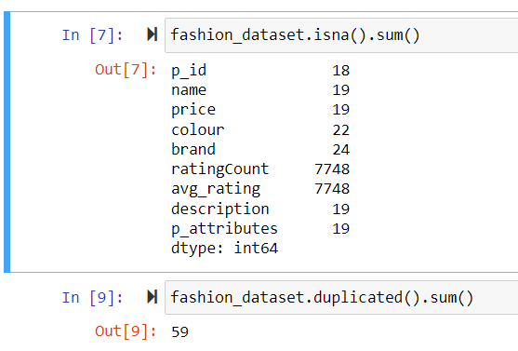
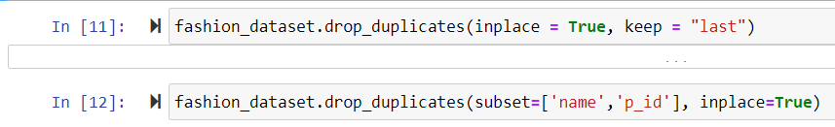
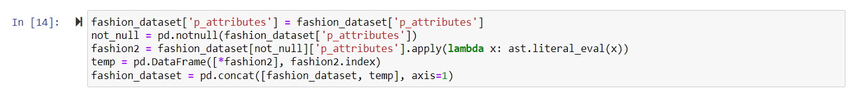
DATA CLEANING (1/4)
First, the fashion dataset was checked for duplicate values, which were then dropped.
After these values were dropped, the product attributes or “p_attributes” column was expanded in order to perform cleaning on its components. After expanding the column, the number of columns in the fashion dataset increased from 9 to 115. Using the PandaSQL library, SQL commands were used to inspect the
dataset and 13 of the columns were chosen for analysis.

Slide 7
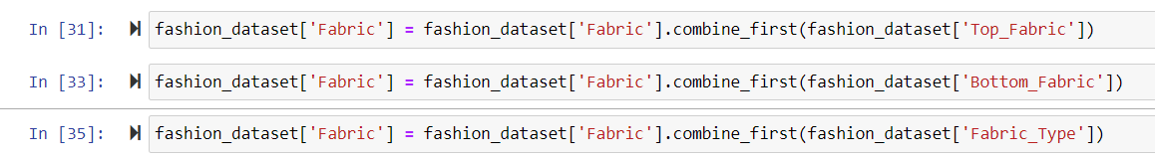
DATA CLEANING (2/4)
Next, the resulting columns were renamed to remove spaces and dashes from their names.
These columns were then filled in with values from corresponding columns within the dataset. For example, the Fabric column was filled using values from Bottom_Fabric”, “Blouse_Fabric”, “Top_Fabric”, “Fabric_Type”, “Dupatta_Fabric”, “Weave_Pattern”, “Saree Fabric”, and “Better_Cotton”.
After filling, the remaining null values in these columns were filled with the mode value of each column.

Slide 8
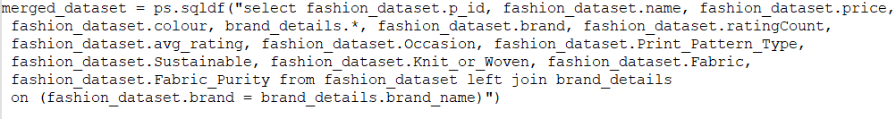
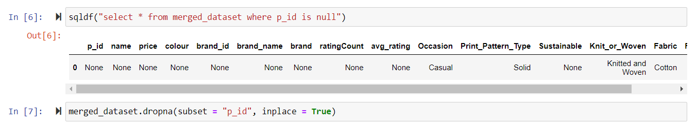
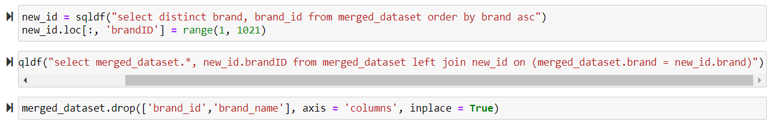
DATA CLEANING (3/4)
The fashion dataset was then merged with the brand details dataset using an SQL left join.
The product ID, name, price, and brand columns of the merged dataset were inspected using SQL commands, and their null values were dropped. Next, the brand ID column was filled with a range of numbers from 1 to 1020, for each unique brand. The brand name column from the brand details dataset was also dropped.

Slide 9
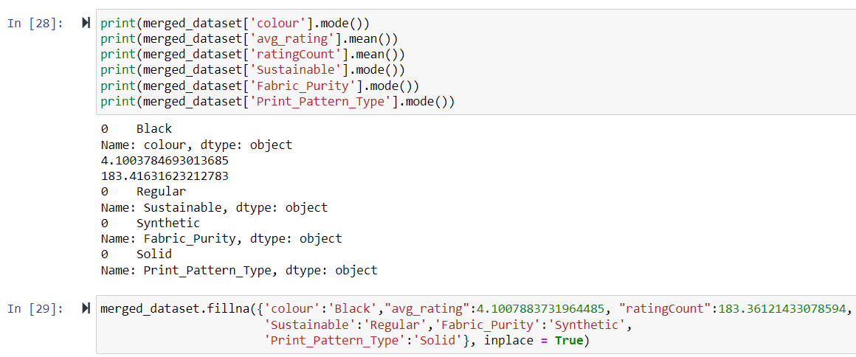
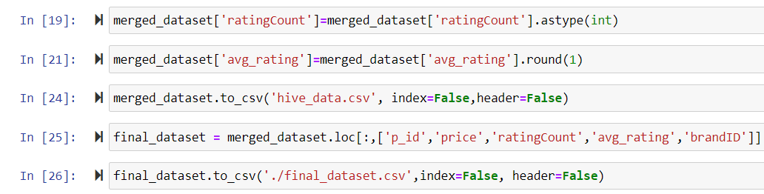
DATA CLEANING (4/4)
Finally, the average rating and rating count columns were filled with their respective mean values, and the colour column, as well as the remaining columns containing null values were filled with their mode values. The rating count column was also converted to an integer, and the average rating values were rounded up to one decimal place.
The dataset was then exported for analysis using Apache HIVE.

Slide 10
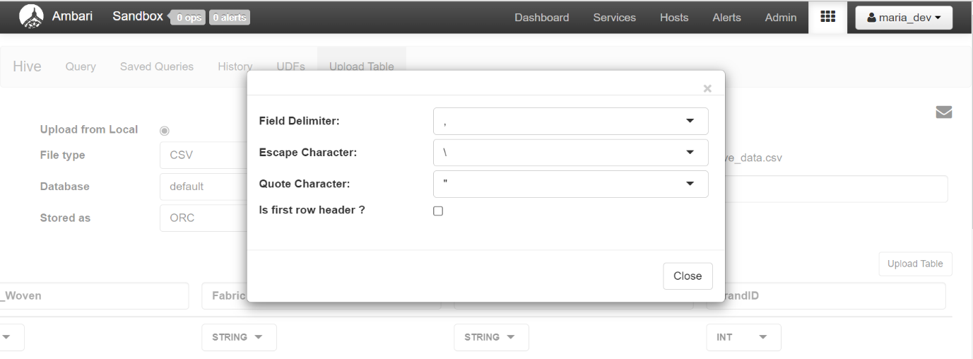
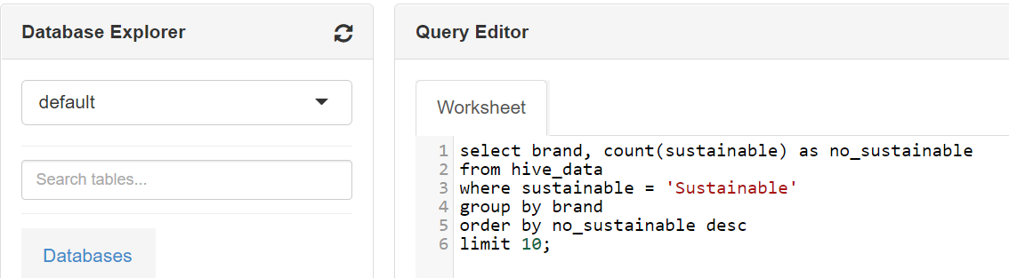
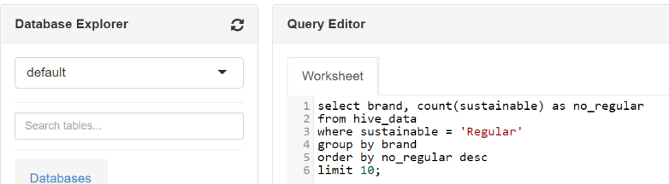
APACHE HIVE(1/2)
The dataset was imported into the HIVE view of the Ambari Sandbox and the headers were manually imputed. HIVE was used to identify the top 10 most sustainable brands, as well as the 10 most unsustainable brands in the dataset, by checking the number of each kind of product in each column.

Slide 11
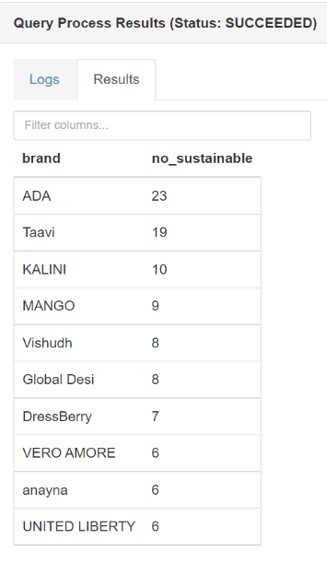
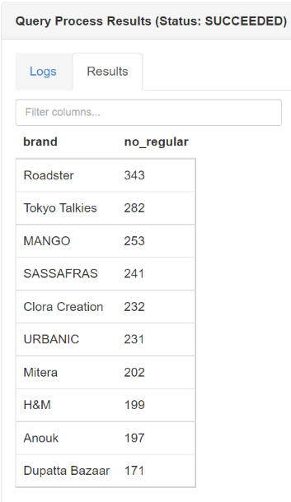
APACHE HIVE (2/2)
The results of the queries showed there were more unsustainable than sustainable brands.
Truly sustainable brands were found to be so rare, in fact, that MANGO, a brand with 253 unsustainable clothing items, was included in the list of sustainable brands.
From the results of this analysis, two new datasets were created for analysis using MapReduce. MANGO was excluded from both datasets.

Slide 12
APACHE MAPREDUCE (1/3)
The new datasets contained the product IDs, prices, average ratings, rating counts, and brand IDs of all products belonging to the least sustainable and most sustainable brands. They were exported from Jupyter Notebook and imported into the Hadoop environment using the Hortonworks Sandbox SSH.
Using the MRJob library, MapReduce was used to determine the relationship between sustainability and popularity, as well as between sustainability and price. Popularity was measured by calculating the mean of the product average ratings for each brand, while price was measured by calculating the mean of the product prices.

Slide 13
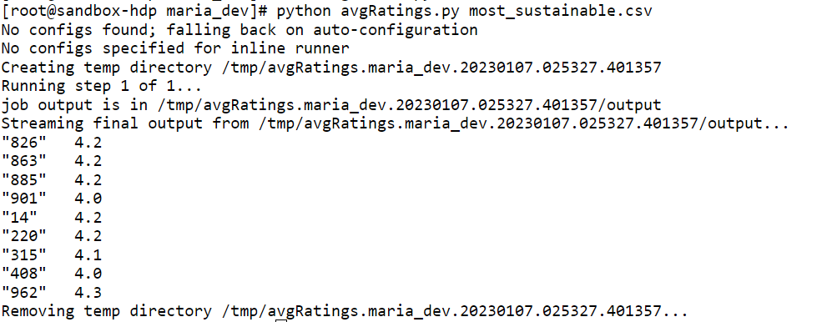
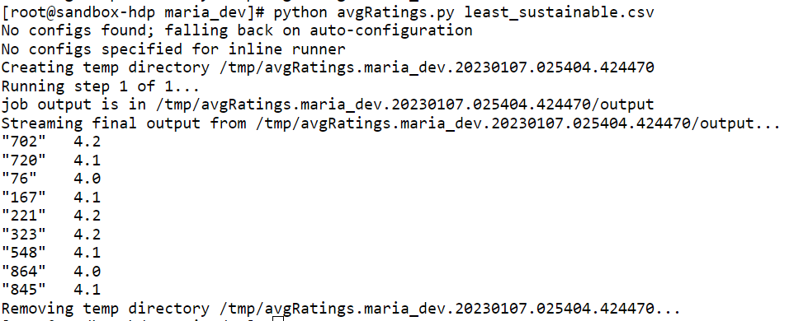
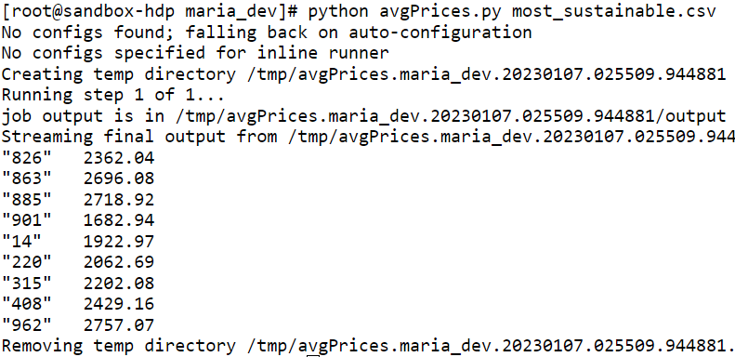
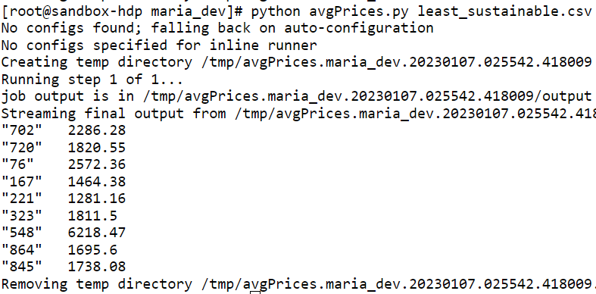
APACHE MAPREDUCE (2/3)
The data gave no indication of which level of sustainability is more popular.
However, there was a clear difference in price. With the exception of one outlier, sustainable brands were, on average, more expensive than unsustainable ones.

Slide 14
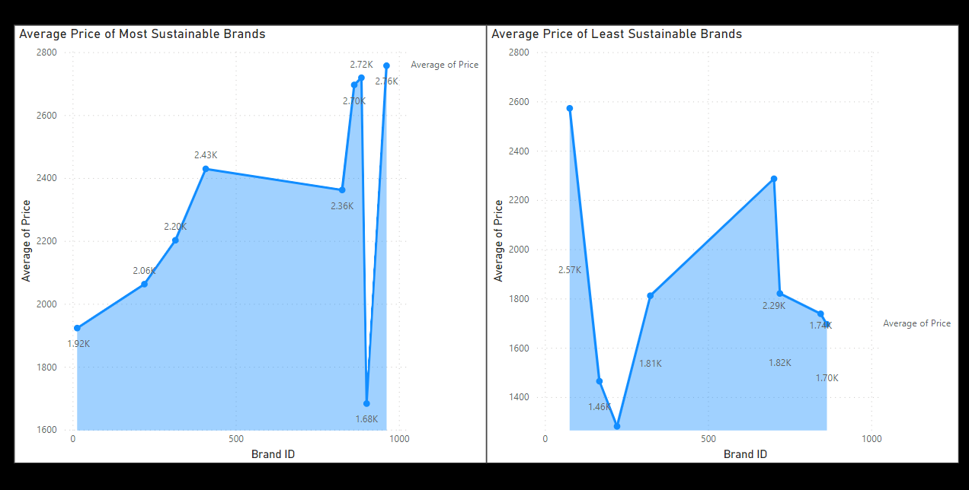
APACHE MAPREDUCE (3/3)
The relationship between price and sustainability was demonstrated using area charts created in Power BI, with brand number 548, the outlier, excluded.

Slide 15
MACHINE LEARNING (1/2)
Two classification models were trained in this study to predict the sustainability of products in the fashion industry dataset. The two models used were the Decision Tree and Random Forest classifiers.
The elements of the data were first encoded using the LabelEncoder, after which the data was split into a 75:25 ratio for training and testing using train_test_split.
The Decision Tree classifier showed an accuracy score of 97.25%, while the Random Forest classifier had an accuracy of 98.71%.

Slide 16
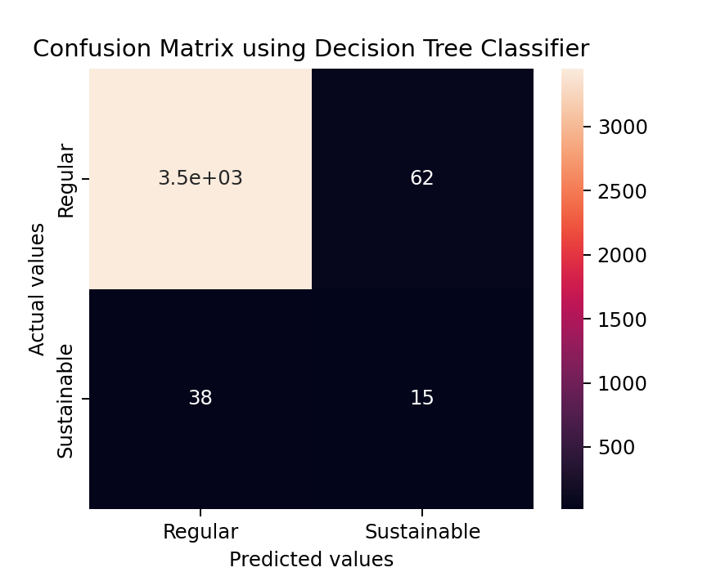

MACHINE LEARNING (2/2)
Confusion matrices were created for both models, in order to take a deeper look into their predictions. They were then visualised using Seaborn heatmaps, and it was revealed that both models had some difficulty correctly predicting “Sustainable” products but were almost entirely accurate in predicting “Regular” products.

Slide 17
DISCUSSION
The fast fashion industry has leveraged the quick pace of the modern world in a way that no other fashion brands have. It has created a market for affordable, trendy clothing for people in all situations, and has used big data technologies to increase its profitability and facilitate its growth.
Despite its popularity, the business model has faced some backlash in recent years for its unethical and unsustainable practices, although this does not seem to affect its bottom line. Fashion has become a seasonal thing, with clothes having increasingly short life cycles.
Research has shown that certain colours, patterns, and designs have higher sales at certain times, and the fashion industry datasets reflect this. When clothing is out of season or damaged due to low quality, it is simply thrown out.

Slide 18
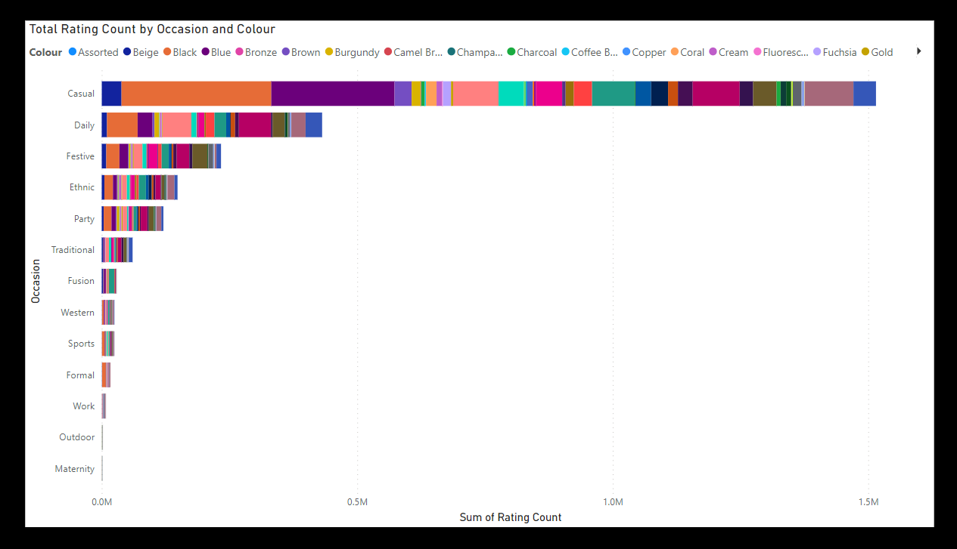
DISCUSSION (2/2)
The figure below illustrates the different colours of clothing that are most popular for each occasion according to the fashion industry dataset.
Using this information, as well as information gathered using big data techniques, more sustainable “slow fashion” brands can gain a competitive edge in the market and bring ethical and environmentally conscious practices back into the fashion industry. With some improvement, machine learning models like the two above can also give insights both to brands and to consumers.

Slide 19
THANK YOU

